Slide 1
Design and Analysis of Algorithms
Spring-2023
National University of Computer and Emerging Sciences, Islamabad

Slide 2
Dynamic Programming

Slide 3
Dynamic Programming
Dynamic programming is applicable, when the sub-problems are NOT independent in simple recursion, that is when sub-problems share sub sub-problems.
It is making a set of choices to arrive at optimal solution.
In worst case, we may end-up with an exponential time algorithm.

Slide 4
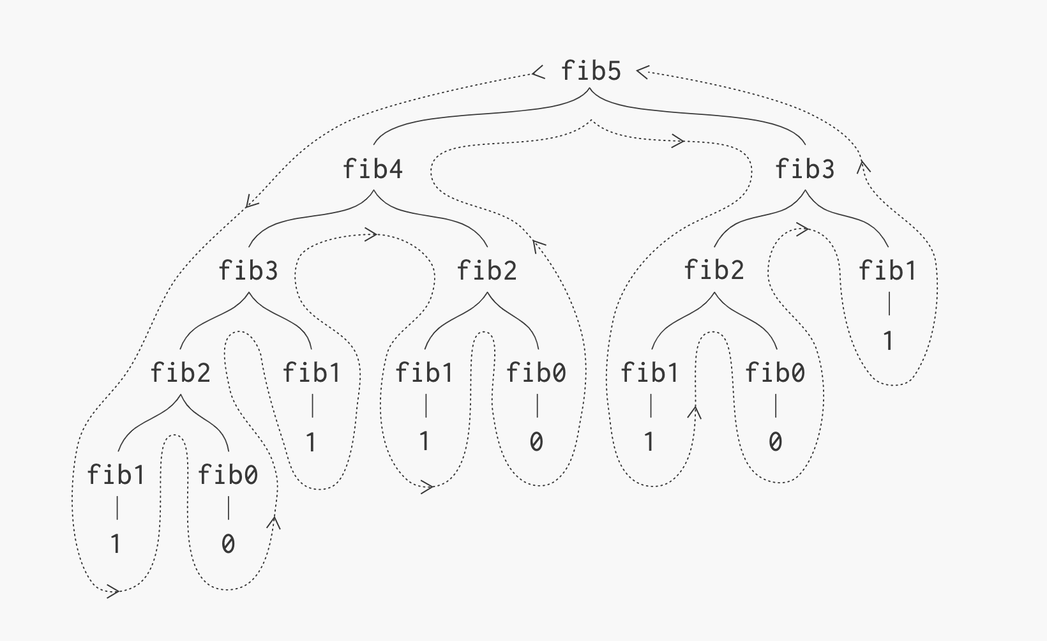
Recursive Fibonacci Tree

Slide 5
Dynamic Programming
Frequently, there is a polynomial number of sub-problems, but they get repeated.
A dynamic programming algorithm solves every sub-problem just once and then saves its answer in a table, thereby avoiding the work of re-computing the answer every time the sub-problem is encountered
So we end up having a polynomial time algorithm.
Which is better, Dynamic Programming or simple recursion?

Slide 6
Optimization Problems
Dynamic problem is typically applied to Optimization Problems
In optimization problems there can be many possible solutions. Each solution has a value and the task is to find the solution with the optimal ( Maximum or Minimum) value. There can be several such solutions.

Slide 7
4 Steps of Dynamic Programming Algorithm
1. Characterize the structure of an optimal solution.
2. Recursively define the value of an optimal solution.
3. Compute the value of an optimal solution bottom-up (iteratively) or top-down (recursive) using memoization.
4. Construct an optimal solution from computed information
Often only the value of the optimal solution is required so step-4 is not necessary.

Slide 8
Recursive Definition of the Fibonacci Numbers
The Fibonacci numbers are a series of numbers as follows:
fib(1) = 1
fib(2) = 1
fib(3) = 2
fib(4) = 3
fib(5) = 5
...
fib(n) =
1, n <= 2
fib(n-1) + fib(n-2), n > 2
fib(3) = 1 + 1 = 2
fib(4) = 2 + 1 = 3
fib(5) = 2 + 3 = 5

Slide 9
Recursive Fibonacci Tree

Slide 10
Recursive Algorithm (seen earlier)
Takes Exponential time
Actual sub problems are polynomial (O(n)) but they get repeated
Sub problems are not INDEPENDENT.
Sub problems share sub-sub problems.
We can solve it using Dynamic programming.

Slide 11
Memoized Recursive Algorithm – Top Down (Simple recursion is top-down)
D[0] | D[1] | D[2] | D[3] | D[4] | D[5]
1 | 1 | -1 | -1 | -1 | -1
int[ ] d = new int[n+1];
for (int j = 2; j<=n; j++)
d[j] = -1;
d[0] = 1;
d[1] = 1;
int fibonacci(int n)
{
if (d[n-1] < 0) // when n=2, condition is false
d[n-1] = fibonacci(n-1);
return (d[n-1]+d[n-2]);
}

Slide 12
Bottom-up Algorithm – Iterative
memo = [ ] //new array
FIBONACCI-BOTTOM-UP(n)
BEGIN
memo[0] = 1
memo[1] = 1
FOR i: 2 to n DO
memo[i] = memo[i-1] + memo[i-2]
END FOR
RETURN memo[n]
END

Slide 13
Next step is to further optimize the space complexity
  At every step, store only the last two values
  Try to write it yourself

Slide 14
Dynamic Programming
Rod Cutting Problem

Slide 15
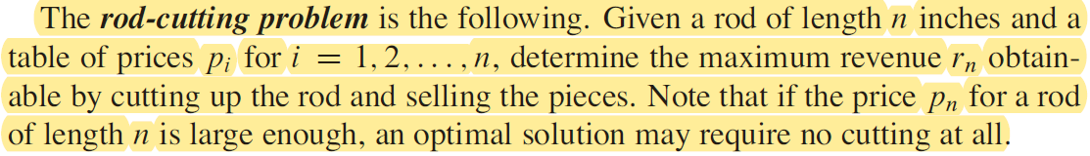
Problem Statement

Slide 16

We can cut up a rod of length n in 2^{n-1} different ways.
Suppose the price of each piece is known:

Slide 17
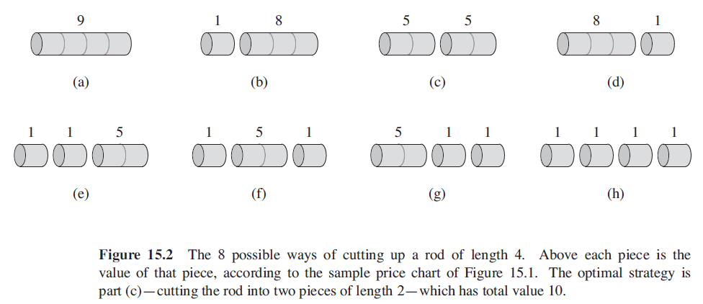
4 inches rod: n=4
Possible combinations of cutting a 4 inches rod.

Slide 18
Rod Cutting
Note: We’ve computed a brute force solution; all possibilities for this simple small example. But we want a better solution!
One solution:
recurse on further
i
n-i
What are we doing?
- Cut rod into length i and n-i
Only remainder n-i can be further cut (recursed)
We need to define:
a.) Maximum revenue for log of size n: r_{n} (that is the solution we want to find).
b.) Revenue (price) for single log of length i: p_{i}

Slide 19
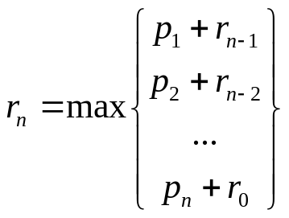
Rod Cutting
Example: If we cut log into length i and n-i:
recurse on further
i
n-i
Revenue: p_{i} + r_{n-i}
Can be seen by recursing on n-i
What are we going to do?
There are many possible choices of i:

Slide 20
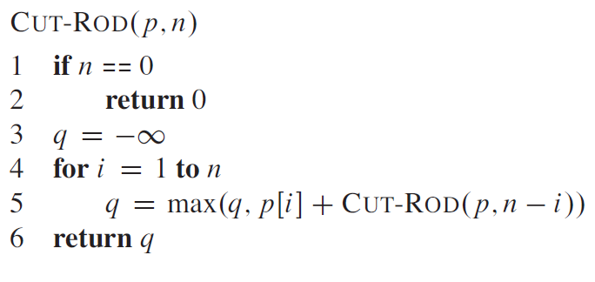
Recursive top-down implementation

Slide 21
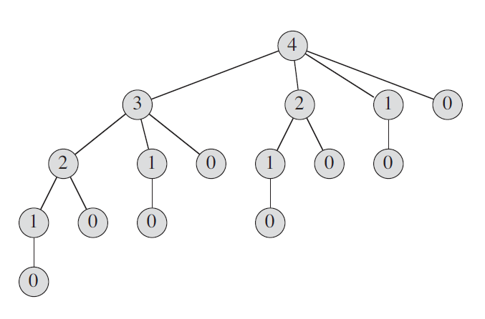


Slide 22
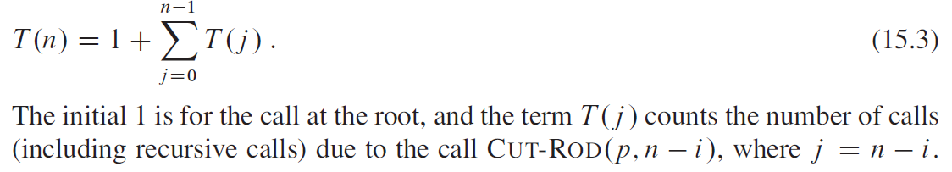
CUT-ROD explicitly considers all the 2^{n-1} possible ways of cutting up a rod of length n.
The tree of recursive calls has 2^{n-1} leaves, one for each possible way of cutting up the rod.

Slide 23
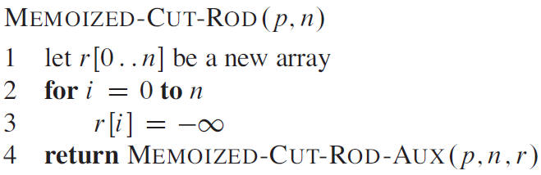
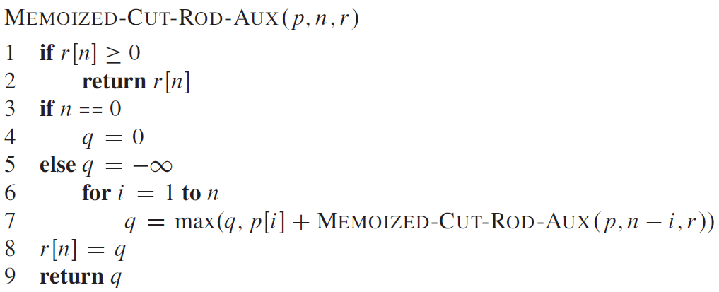
Top Down with memoization

Slide 24
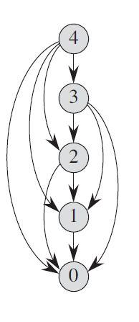
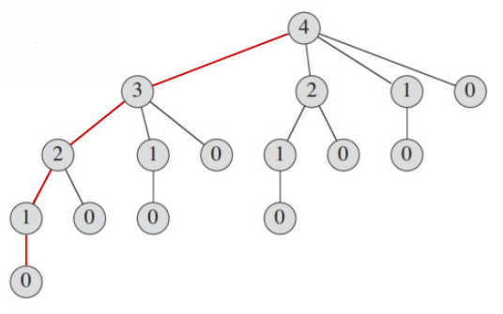

Slide 25
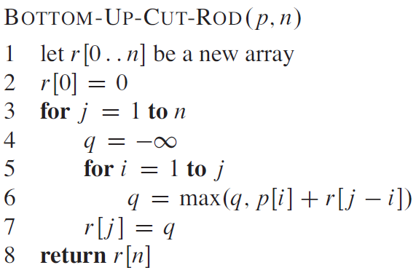
Bottom Up

Slide 26
Running Time
The bottom-up and top-down versions have the same asymptotic running time.
The running time of procedure BOTTOM-UP-CUT-ROD is Θ(n²)

Slide 27
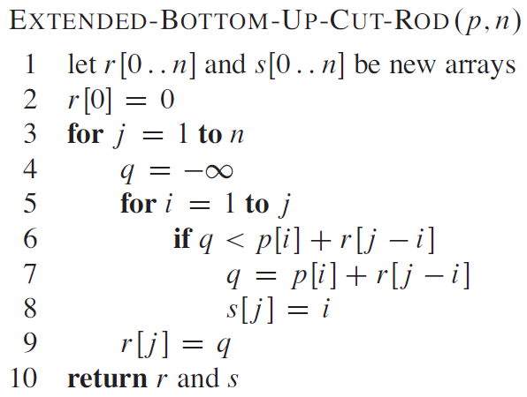
Extended Bottom Up – storing sizes

Slide 28
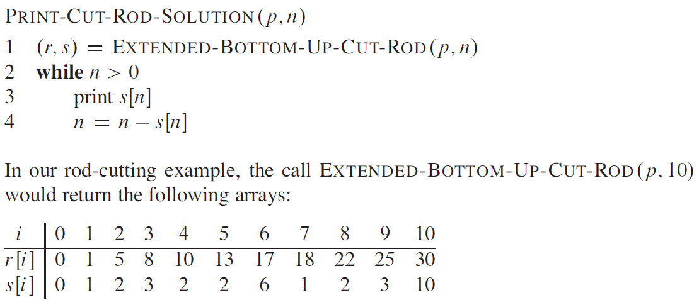

Slide 29
Matrix-chain Multiplication
Suppose we have a sequence or chain A₁, A₂, …, A_{n} of n matrices to be multiplied
  That is, we want to compute the product A₁A₂…A_{n}
There are many possible ways (parenthesizations) to compute the product

Slide 30
Matrix-chain Multiplication …contd
Example: consider the chain A₁, A₂, A₃, A₄ of 4 matrices
  Let us compute the product A₁A₂A₃A₄
There are 5 possible ways:
  (A₁(A₂(A₃A₄)))
  (A₁((A₂A₃)A₄))
  ((A₁A₂)(A₃A₄))
  ((A₁(A₂A₃))A₄)
  (((A₁A₂)A₃)A₄)

Slide 31
Matrix-chain Multiplication …contd
To compute the number of scalar multiplications necessary, we must know:
  Algorithm to multiply two matrices
  Matrix dimensions
Can you write the algorithm to multiply two matrices?

Slide 32
Algorithm to Multiply 2 Matrices
Input: Matrices A_{p×q} and B_{q×r} (with dimensions p×q and q×r)
Result: Matrix C_{p×r} resulting from the product A·B
MATRIX-MULTIPLY(A_{p×q} , B_{q×r})
1. for i ← 1 to p
2. for j ← 1 to r
3. C[i, j] ← 0
4. for k ← 1 to q
5. C[i, j] ← C[i, j] + A[i, k] · B[k, j]
6. return C
Scalar multiplication in line 5 dominates time to compute C Number of scalar multiplications = pqr

Slide 33
Matrix-chain Multiplication
Example: Consider three matrices A_{10×100}, B_{100×5}, and C_{5×50}
There are 2 ways to parenthesize
  ((AB)C) = D_{10×5} · C_{5×50}
    AB ⇒ 10·100·5=5,000 scalar multiplications
    DC ⇒ 10·5·50 =2,500 scalar multiplications
  (A(BC)) = A_{10×100} · E_{100×50}
    BC ⇒ 100·5·50=25,000 scalar multiplications
    AE ⇒ 10·100·50 =50,000 scalar multiplications
Total: 7,500
Total: 75,000

Slide 34
Matrix-chain Multiplication …contd
Matrix-chain multiplication problem
  Given a chain A₁, A₂, …, A_{n} of n matrices, where for i=1, 2, …, n, matrix A_{i} has dimension p_{i-1}×p_{i}
  Parenthesize the product A₁A₂…A_{n} such that the total number of scalar multiplications is minimized
Brute force method of exhaustive search takes time exponential in n

Slide 35
Dynamic Programming Approach
The structure of an optimal solution
  Let us use the notation A_{i..j} for the matrix that results from the product A_{i} A_{i+1} … A_{j}
  An optimal parenthesization of the product A₁A₂…A_{n} splits the product between A_{k} and A_{k+1} for some integer k where1 ≤ k < n
  First compute matrices A_{1..k} and A_{k+1..n} ; then multiply them to get the final matrix A_{1..n}

Slide 36
Dynamic Programming Approach …contd
  Key observation: parenthesizations of the subchains A₁A₂…A_{k} and A_{k+1}A_{k+2}…A_{n} must also be optimal if the parenthesization of the chain A₁A₂…A_{n} is optimal (why?)
  That is, the optimal solution to the problem contains within it the optimal solution to subproblems

Slide 37
Dynamic Programming Approach …contd
Recursive definition of the value of an optimal solution
  Let m[i, j] be the minimum number of scalar multiplications necessary to compute A_{i..j}
  Minimum cost to compute A_{1..n} is m[1, n]
  Suppose the optimal parenthesization of A_{i..j} splits the product between A_{k} and A_{k+1} for some integer k where i ≤ k < j

Slide 38
Dynamic Programming Approach …contd
  A_{i..j} = (A_{i} A_{i+1}…A_{k})·(A_{k+1}A_{k+2}…A_{j})= A_{i..k} · A_{k+1..j}
  Cost of computing A_{i..j} = cost of computing A_{i..k} + cost of computing A_{k+1..j} + cost of multiplying A_{i..k} and A_{k+1..j}
  Cost of multiplying A_{i..k} and A_{k+1..j} is p_{i-1}p_{k} p_{j}
  m[i, j ] = m[i, k] + m[k+1, j ] + p_{i-1}p_{k} p_{j} for i ≤ k < j
  m[i, i ] = 0 for i=1,2,…,n

Slide 39
Dynamic Programming Approach …contd
  But… optimal parenthesization occurs at one value of k among all possible i ≤ k < j
  Check all these and select the best one
0 if i=j
m[i, j ] =
min {m[i, k] + m[k+1, j ] + p_{i-1}p_{k} p_{j} } if i<j
i ≤ k< j

Slide 40
Dynamic Programming Approach …contd
To keep track of how to construct an optimal solution, we use a table s
s[i, j ] = value of k at which A_{i} A_{i+1} … A_{j} is split for optimal parenthesization
Algorithm: next slide
  First computes costs for chains of length l=1
  Then for chains of length l=2,3, … and so on
  Computes the optimal cost bottom-up

Slide 41
Algorithm to Compute Optimal Cost
Input: Array p[0…n] containing matrix dimensions and n
Result: Minimum-cost table m and split table s
MATRIX-CHAIN-ORDER(p[ ], n)
for i ← 1 to n
m[i, i] ← 0
for l ← 2 to n
for i ← 1 to n-l+1
j ← i+l-1
m[i, j] ← ∞
for k ← i to j-1
q ← m[i, k] + m[k+1, j] + p[i-1] p[k] p[j]
if q < m[i, j]
m[i, j] ← q
s[i, j] ← k
  return m and s
Takes O(n³) time
Requires O(n²) space

Slide 42
Constructing Optimal Solution
Our algorithm computes the minimum-cost table m and the split table s
The optimal solution can be constructed from the split table s
  Each entry s[i, j ]=k shows where to split the product A_{i} A_{i+1} … A_{j} for the minimum cost

Slide 43
Example
Show how to multiply this matrix chain optimally
Solution
  Minimum cost 15,125
  Optimal parenthesization ((A₁(A₂A₃))((A₄ A₅)A₆))
Matrix | Dimension
A₁ | 30×35
A₂ | 35×15
A₃ | 15×5
A₄ | 5×10
A₅ | 10×20
A₆ | 20×25

Slide 44
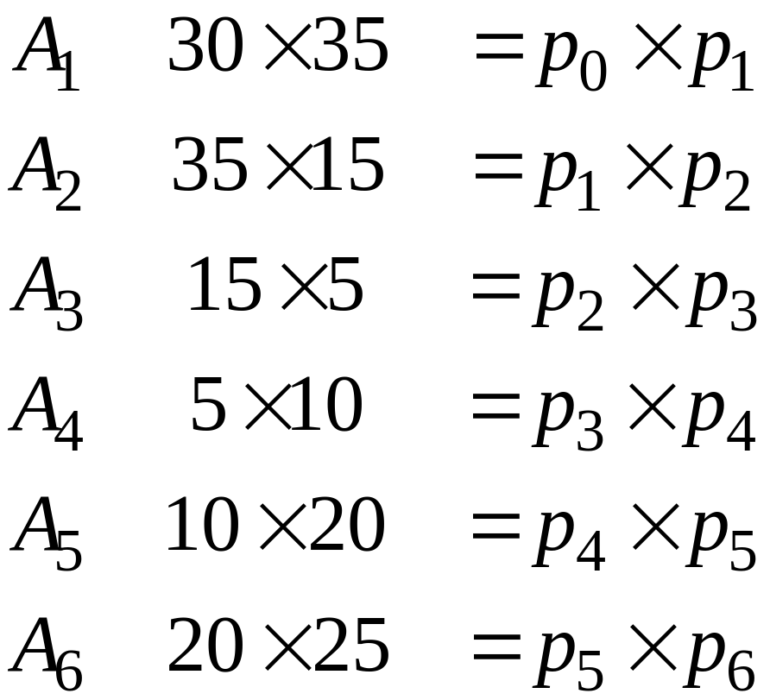
Example:

Slide 45
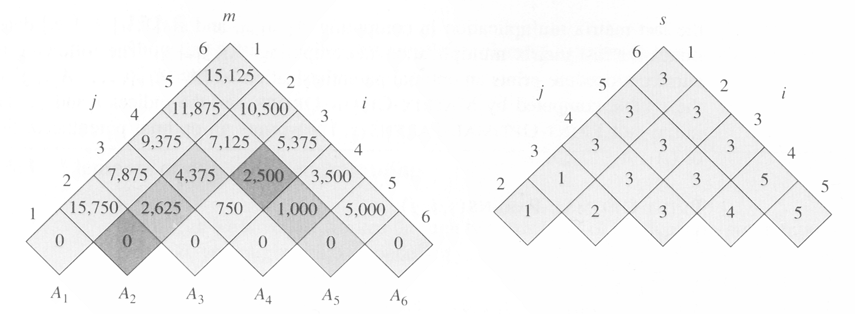
Order Matrix Size Products
A2 x A3 = 35 x 5 2,625
A1 (A2 x A3) = 30 X 5 5,250 + 2,625
the m and s table computed by
MATRIX-CHAIN-ORDER for n=6

Slide 46
m[2,5]=
min{
m[2,2]+m[3,5]+p₁p₂p₅=0+2500+35×15×20=13000,
m[2,3]+m[4,5]+p₁p₃p₅=2625+1000+35×5×20=7125,
m[2,4]+m[5,5]+p₁p₄p₅=4375+0+35×10×20=11374
}
=7125

Slide 47
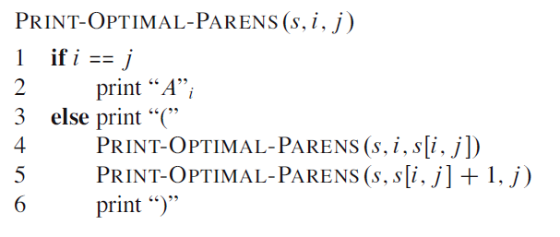

Constructing the optimal solution
example:

Slide 48
Elements of dynamic programming
When should we look for a dynamic programming solution to a problem?
Two key ingredients?
  Optimal sub-structure
  Overlapping sub-problems

Slide 49
Elements of dynamic programming
Optimal sub-structure
A problem exhibits optimal sub-structure, if an optimal solution to a problem contains within it optimal solutions to sub-problems.

Slide 50
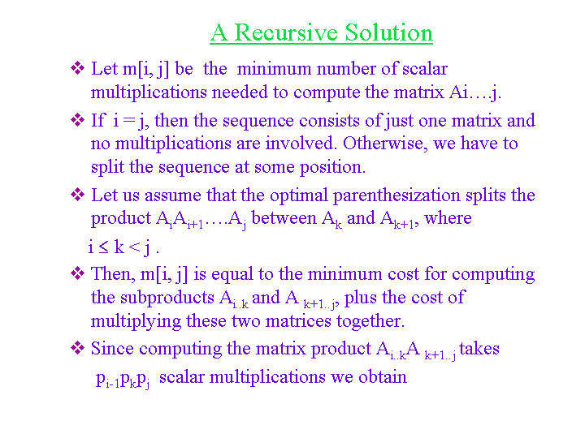

Slide 51
Overlapping Sub problems
Two ways of solving the same problem:
Top-down approach
This being based on recursion i.e. recursively solving the larger problem by breaking it down
Bottom-Up approach
This being based on dynamic programming. Starting with the smallest sub-problems, solving them and using their solutions

Slide 52
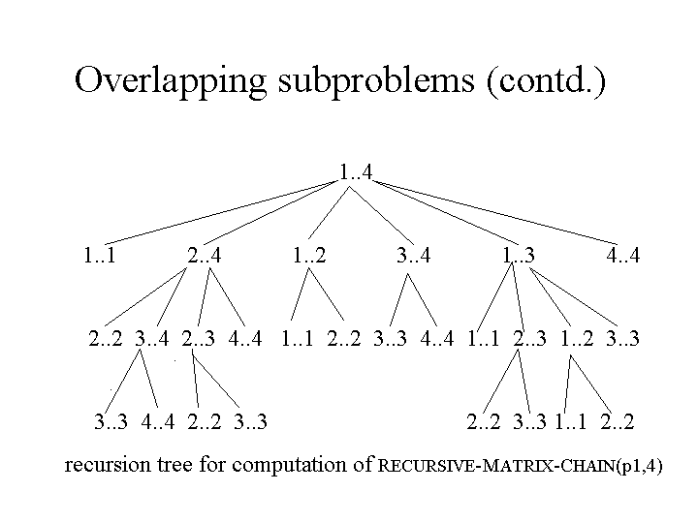

Slide 53
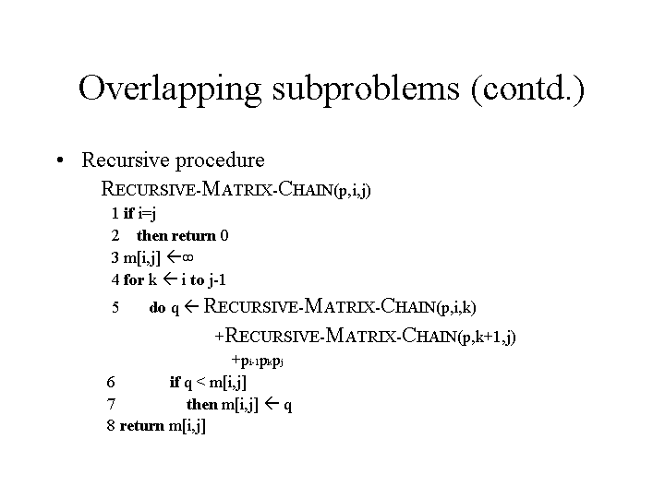

Slide 54
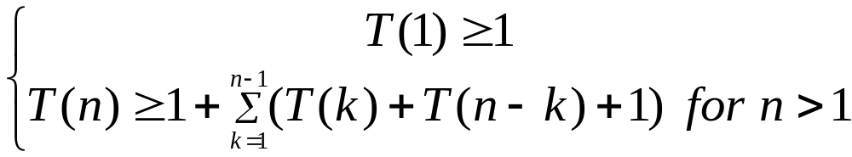
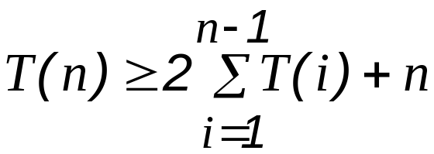
Overlapping Sub problems
Running time of recursive procedure, where T(n) is the running time of computing m[1,n] :
We can prove that T(n) =Ω(2^{n}).

Slide 55
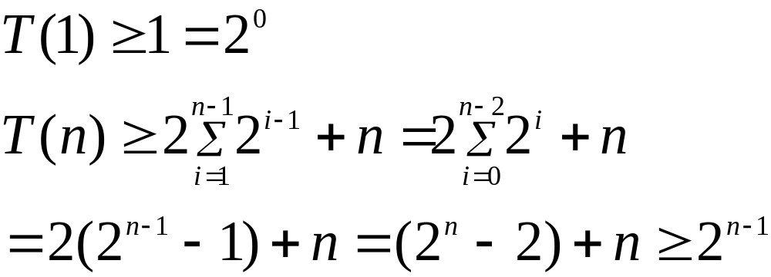

Slide 56
Overlapping Sub problems
Top-down approach Vs Bottom-Up approach
Bottom-Up approach
More efficient because it takes advantage of the overlapping sub-problem property. There are only θ(n²) different sub-problems. Each problem solved exactly once.
Top-down approach
Must repeatedly resolve each sub-problem, each time it reappears in the recursion.

Slide 57
Memoization
A variation of Dynamic Programming and is TOP-DOWN
Memoize the natural, but inefficient, recursive algorithm.
Maintains an entry in the table for the solution to each sub-problem.
Offers efficiency while maintaining top-down strategy.

Slide 58
Memoization
A special character stored at each empty solution space.
When the sub-problem is first encountered, it’s solution is computed and stored.
Each subsequent time the sub-problem is encountered, its solution is looked up.
Time to search the sub-problem solutions?

Slide 59
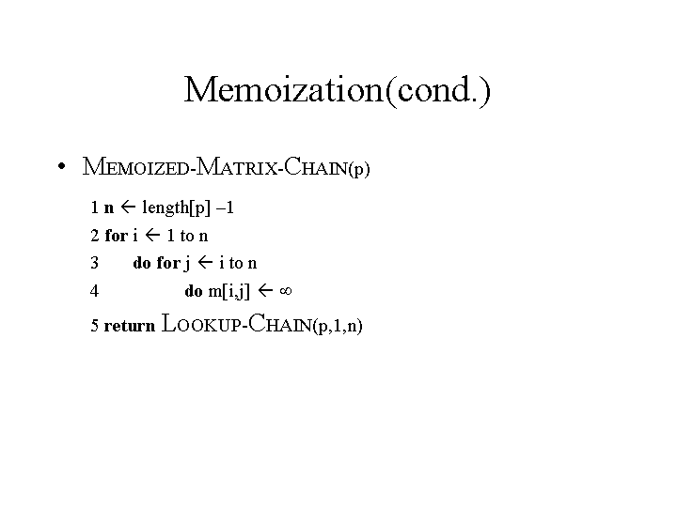

Slide 60
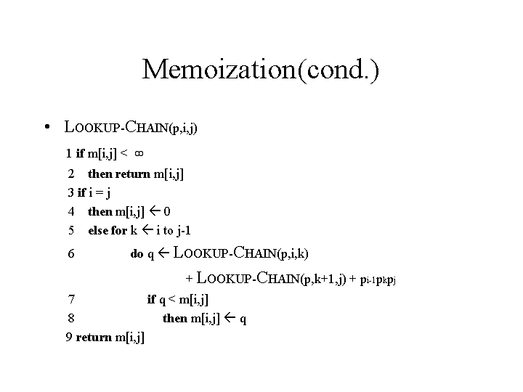
Memoization

